Slide 1


"Science for sustainability: why inter-connected problems call for inter-connected knowledge“
- or –
“SAVING THE WORLD, FLIPCHART BY FLIPCHART
Joe Ravetz
Centre for Urban Resilience & Energy
University of Manchester
www.urban3.net

Slide 2
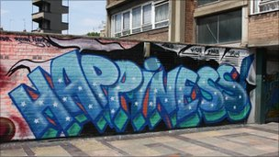
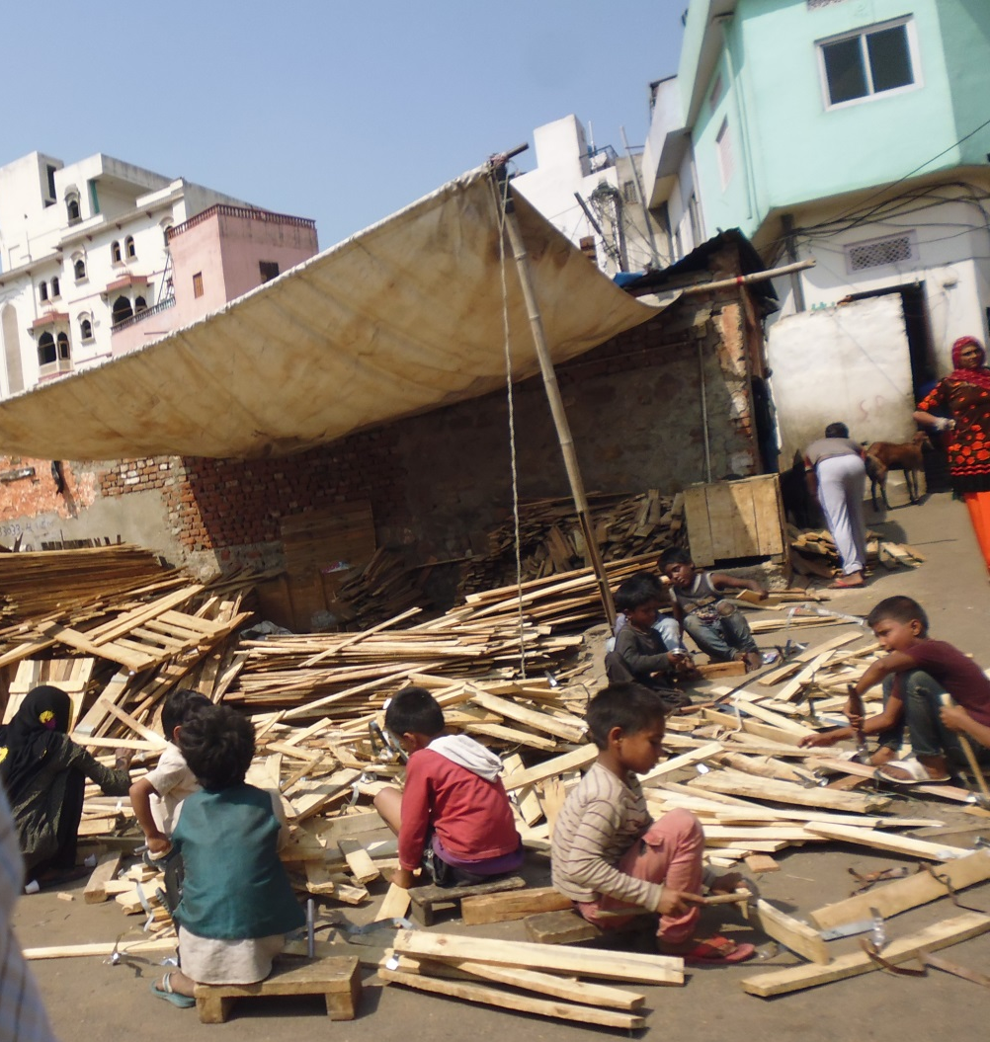
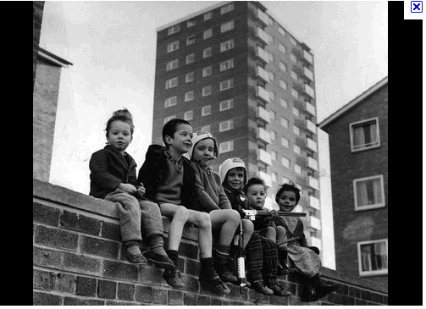
CONTENTS
The objectives
Introductions…
1st Case study: climate
1st Science agenda: synergistics
1st Conversation:
2nd Case study: bio-regions
2nd Science agenda: co-evolution:
2nd conversation:
Mind-games….
The clients

Slide 3
Introductions

Slide 4
AUTHOR’S NOTE
Then came a mystic Journey to the East... infinite consciousness beckoned ... but it seemed there were things to do here first.
1970s London & the squatting community. Capitalism & socialism in crisis. We created Local Exchange systems & other alternatives.
Hi & welcome to this journey
From an early age I designed cities & math-ematical models
My name is Joe & I’m your author for today... I’d like to say a few words about where this is all coming from
I went North...built a house, started a family. I got to know wood, stone, metal.
Did a ‘Future City’ conference... ‘Community Development Framework’... ‘Tomorrow’s Communities’ for the new urban fringe.. A networked science park...
in 1992 we realized the new word ‘sustainability’ brought together all these ideas.
With the TCPA*, I set up the ‘Sustainable City-region’ program
Finished training, practiced as a community architect & planner
*TCPA = Town & Country Planning Association, originators of the Garden City concept

Slide 5
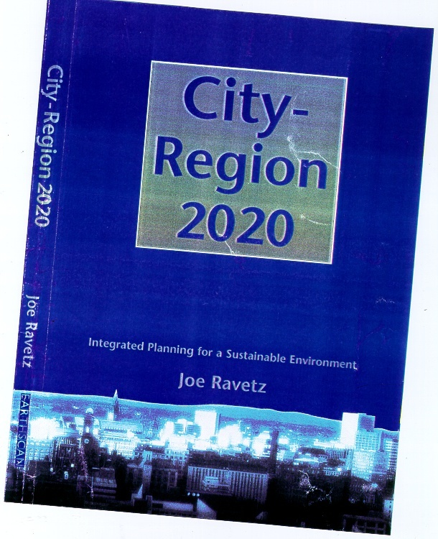
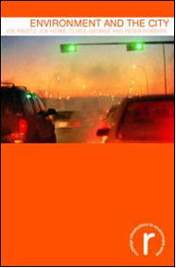
Commercial Break / Work in progress www.urban3.net
Urban 3.0
Creative synergy & shared intelligence for the one planet city
“Environment and the City” - critical perspectives on the human urban environment around the world
“World’s largest feasibility study” – linking spatial, economy, environment, society, governance.
“Local / global transition strategy” – mapping & design of post- complex challenges & opportunities

Slide 6
1st Case study: climate

Slide 7
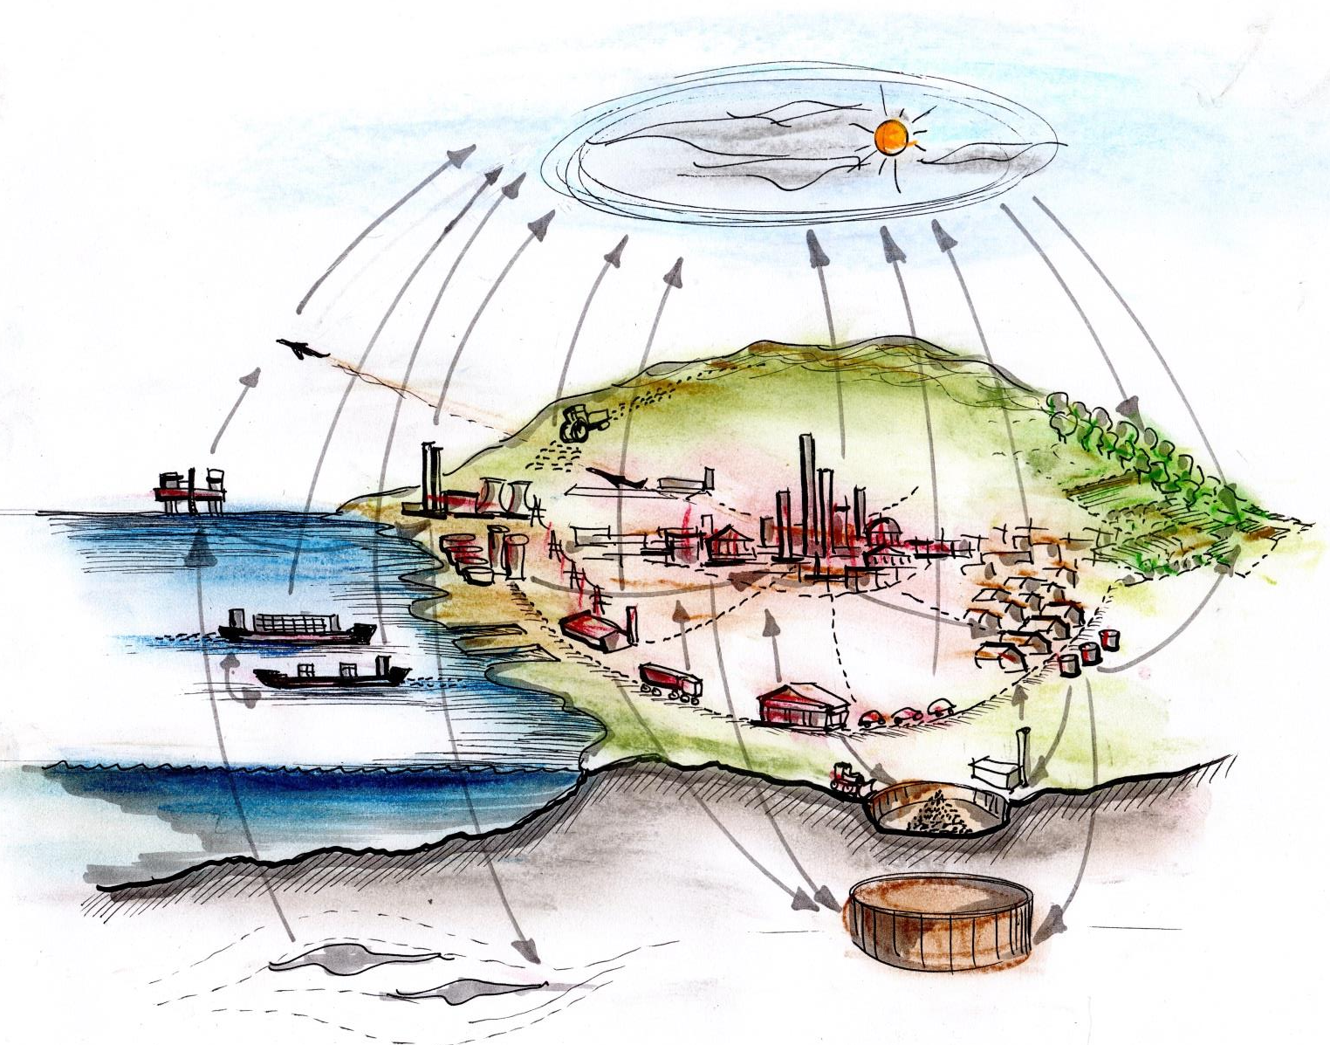
CLIMATE-PROOF CITY: CARBON CYCLE
Agriculture CO2 & other GHG
Aviation CO2 & other radiative forcing
CO2 sequestered in forestry, soil & land
Energy conversion & distribution system
Commercial in/direct CO2 & downstream climate responsibility
Fossil fuel extraction & fugitive emissions
Inbound marine shipping: direct & embodied CO2
Domestic building in/direct CO2 & supply chain
Outbound marine shipping: direct & embodied CO2
Urban transport / infrastructure in/direct CO2
Industrial production & distribution in/direct CO2
Waste stream GHG & embodied CO2 emissions
Fossil fuel reserves extracted
Carbon long term storage in buildings, urban infrastructure, durable products.
Carbon capture & storage in fossil fuel formations

Slide 8
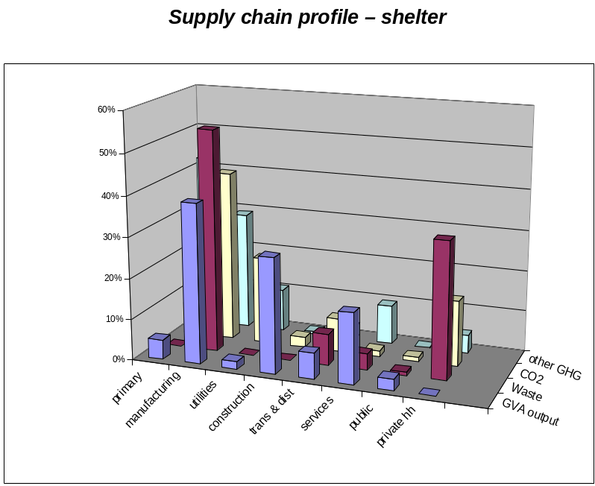
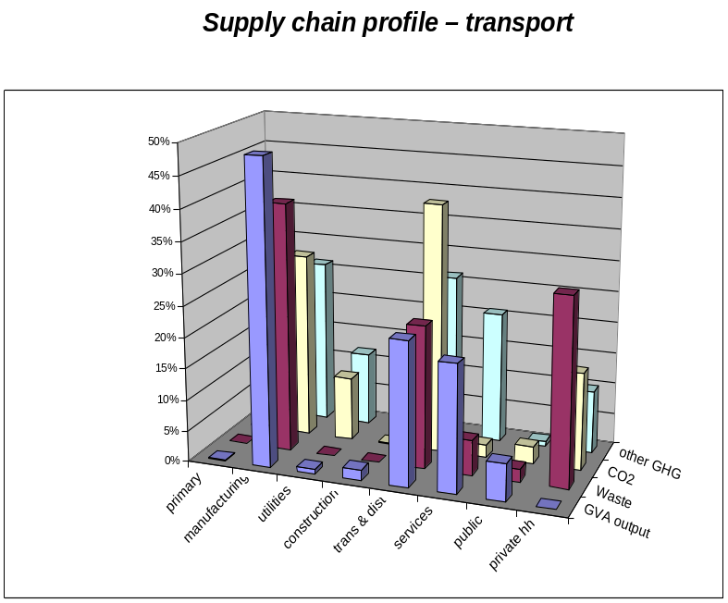
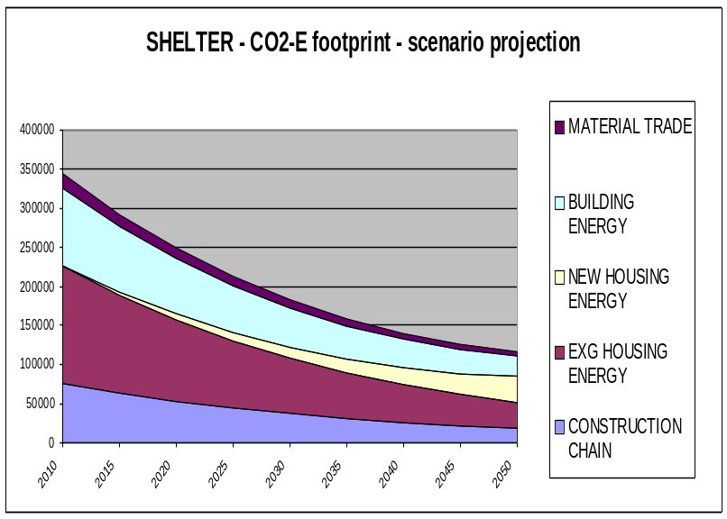
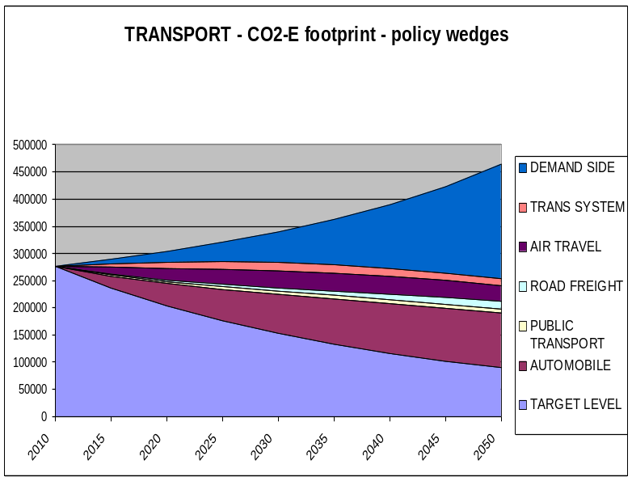
ONE PLANET CITIES UK: RESOURCE FLOW PATHWAYS

Slide 9
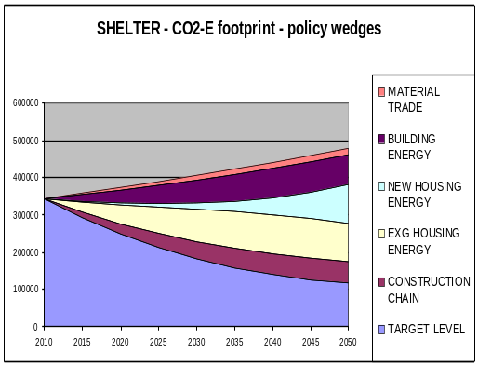
INTEGRATING TECHNICAL SCENARIOS WITH HUMAN PATHWAYS
SCENARIO ‘WEDGES’
SCENARIO-PATHWAY INTERFACE
PATHWAY-SYNERGY MAPPING
‘Policy wedges’ show difference between BAU projections and policy targets, for each broad sector
Scenario parameters shown as technical intensities, e.g. Energy per GVA: CO2 per unit energy, etc. Each intensity has a long story behind it.
Synergistic pathways (social, tech, econ, environ, policy, culture etc) are linked to the parameters on the scenario-pathway interface
Growth trend
Demand shift
FIN
POL
CO2 intensity
Technol. shift
TECH
SOC
“Stabilization”
Energy intensity
ENV
ECON
Demand int.
Climate int.
‘Boundary objects’
Time

Slide 10
EVOLUTIONARY ‘1-2.0’ LOW-CARB
CO-EVOLUTIONARY ‘3.0’ LOW-CARB
MAIN ACTORS / STAKEHOLDERS
Short term profit
Weak & under-funded
Unstable & globalized
Mutual / recirc finance
Network govern models
Re-localize utilities
Fragmented business
Short term & unskilled
SME commu-nities
Construct service compa-nies
Finance
Govern-ment
Infras tructure
fragmented tenure condition & equity
Finance
Govern-ment
Infras tructure
Coord & network housing
Business
Construction
Business
Construction
Labour & skills
Housing
Labour & skills
Housing
Skills / occup gaps
Entrep-reneur incentives
Primary energy
Energy services
Primary energy
Energy services
Second convert
Energy demand
Feedback gap
Renewable incentives
Second convert
Energy demand
fossil fuel incum-bency
Distribution
Distribution
Behaviour intelli-gence
Sunk investment
Centralized grid/storage
Feedback gap
innovation incentives
Smart grid/ storage
Demand intelli-gence
ENERGY SUPPLY-DEMAND METABOLISM

Slide 11
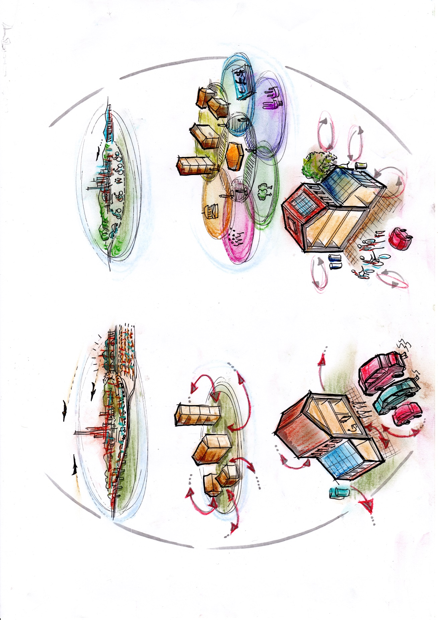
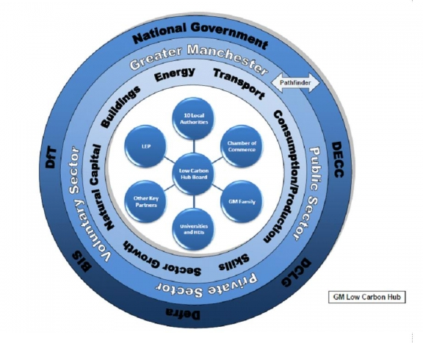
EXAMPLE: “RETROFIT-3”: OVERVIEW
LINEAR MODEL: “UK GREEN DEAL 2013”
SYNERGISTIC MODEL: “GREEN DEAL 3.0”
Housing & other buildings are financial objects without connections.
Apartments have split incentive barriers to efficiency
Physical building is inter-connected with ecology, finance, social, policy, technology value systems
A digital ‘platform’ (eBay / wiki / Amazon / FB etc, is the information connection
Houses are dis-connected from neighbours.
Unplanned ventilation loses heat
A human ‘market-place’ is where people play the role of agents /entrepreneurs /intermediaries / creatives
Waste is sent to landfill
Glasshouse conservatory is heated
Lifestyle includes high power cars & long haul flights
The household is fully integrated: waste, energy supply, ventilation, heat storage, waste recycling, personal transport

Slide 12
EXAMPLE:‘RETROFIT-3’: ACTOR PATHWAYS
ACTORS & SYNDROMES: “GREEN DEAL 2013”
ACTORS & SYNERGIES: “GREEN DEAL 3.0”
media & public sceptics
Disconnec-ted ‘year zero’ policy
Unstable & under-funded
Positive media stories
Social collateral & policy intel
Procurement for eco-inno-vation
Piecemeal design approach
Public housing in a mess
building health mentor role
trusted inter-mediary role
Civic & society
Govern-ment
Public service
Civic & society
Govern-ment
Public services
Science / tech
Social / commun
Science / tech
Social / commun
Profes-sions
Public housing
Profes-sions
Public housing
Finance & devt
Private housing
Finance & devt
Private housing
High finance charges & costs
Construction
Infra-structure
Labour & skills
Private HH inform-ation gaps & inertia
Mutual finance investment & return
Proxy markets / incentives for savings
Construct ion
Infra-structure
Labour & skills
low take-up, frag-mentation
Skills gap, job insecurity
Top-down, distrust, uncertain
Re-socialize utility firms as mutuals
community builder
role
Performance / skills incentive SMEs & workers

Slide 13
EXAMPLE:‘RETROFIT-3’: FACTOR PATHWAYS
PATHWAYS FROM: “GREEN DEAL 2013”
PATHWAYS TO : “GREEN DEAL 3.0”
Finance gap: asymmetric info & distrust: high profit margins: high viability hurdles & short horizons
CIV
GOV
PUB
CIV
GOV
PUB
‘Finance pathway’: links owners, agents, utilities, builders, via integrated mutual-type ‘finance hub’
STI
COM
STI
COM
Finance for innovation
PRO
PH
PRO
PH
FIN
OH
FIN
OH
CON
INF
LAB
CON
INF
LAB
Innovation gaps: Inertia & uncertainty: low invest in technology, plant, skills:
Innovation for finance
‘Innovation pathway’: Technical-professional skills, regulation, standards, led by ‘procurement hubs’
Institutions for innovation
Institutional gaps: Split incentives: owners / landlords won’t invest for benefit of future owners / tenants
‘Institutional pathway’: new tenure & stewardship models via agency for combined value chain incentives
Finance for institutions, etc..

Slide 14
1st science agenda: synergistics

Slide 15
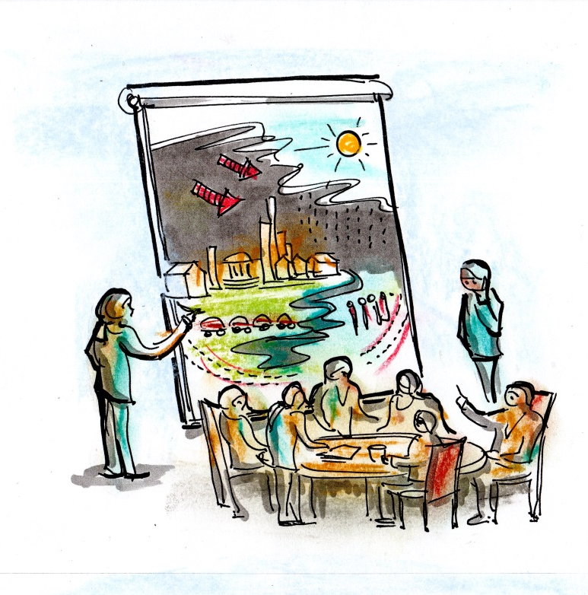
WHERE TO START: LOW CARB CITY EXAMPLE
1) FROM SYNDROMES TO SYNERGIES
Welcome to the “Synergistic Mapping” Quick Tour (with Low-Carb demo)”…
Housing is a Ponzi scheme… energy & water are casino chips
Government can’t keep up with the forces which really run the city
This Low-Carb City looks like a mess… nothing fits…
So this Low-Carb thing - is it an economic cost, technical challenge or social dilemma???
The elite pull all the strings… society is fractured
Our building stock basically warms the sky
Yeah – if we can’t agree on the problem how are we going to find a solution?

Slide 16
WHERE TO START: LOW CARB CITY EXAMPLE
SYNERGISTIC METHODS
CO-EVOLUTIONARY ‘1-2-3.0’ MODELS
So how d’you do this ‘synergistic’ thing??
Easy – first you get people round a table. Then you ask how they get along, & what they do, & how they create “value”...
Some synergies are like parts of a machine… others more biological & others human - it’s like “1-2-3”.
‘1.0’ - a mechanical kind of synergy: this city could be ‘CLEVER’
(& get an artist to draw if possible)
social, economic, ecological or political values?
‘2.0’ - more of a biological synergy, where winners take all: a city which is ‘SMART’
‘3.0’ is really a human kind of synergy, with learning & thinking, where ‘winners are all’: this city is more like ‘WISE’
All of them… you might need a different table for each
And then you look for increased value & reduced conflict, with new inter-connections & synergies

Slide 17
EXAMPLE: LEARNING PLATFORM: SYNERGY FORESIGHT PROCESS
Here’s a typical ‘Synergy Foresight’ programme. This does synergistic mapping & design in 4 main stages & 12 steps
I’s a flexible menu - can take 4 hours, 4 days, 4 weeks or 4 months
The picture shows all 4 stages in 1 room (in reality would be at different times)
At the start, the more things are set up the better – agenda, people, resources etc
First stage is the ‘landscape mapping’ … we explore & draw maps of ‘what is our problem’ & ‘how does this system work’?
Second, the ‘change mapping’ – looks at trends, dynamics, alternative scenarios
(mappings & visuals)
Put visual materials etc on the wall for cross-fertilization
(Tables for specialist discussions)
Finally - either go around the cycle again – or take it out to the world
Fourth stage – ‘pathway / road-mapping’ – here we converge back to practical strategy & action.
Third stage, ‘synergy mapping & design’… the creative side… we look for new collaborations, alignments, learning exchange etc

Slide 18
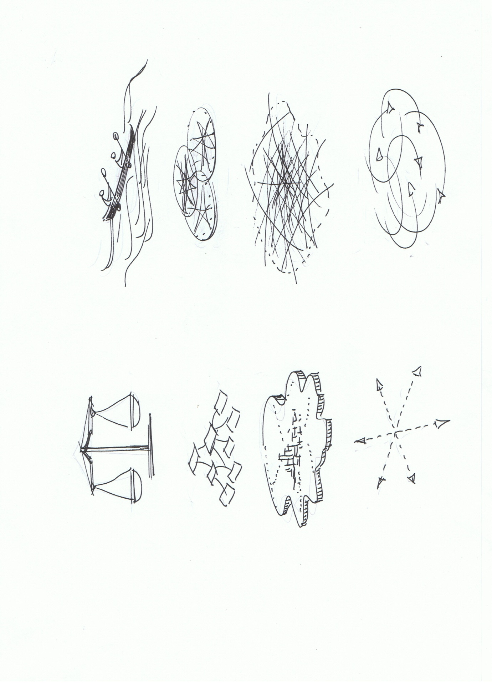
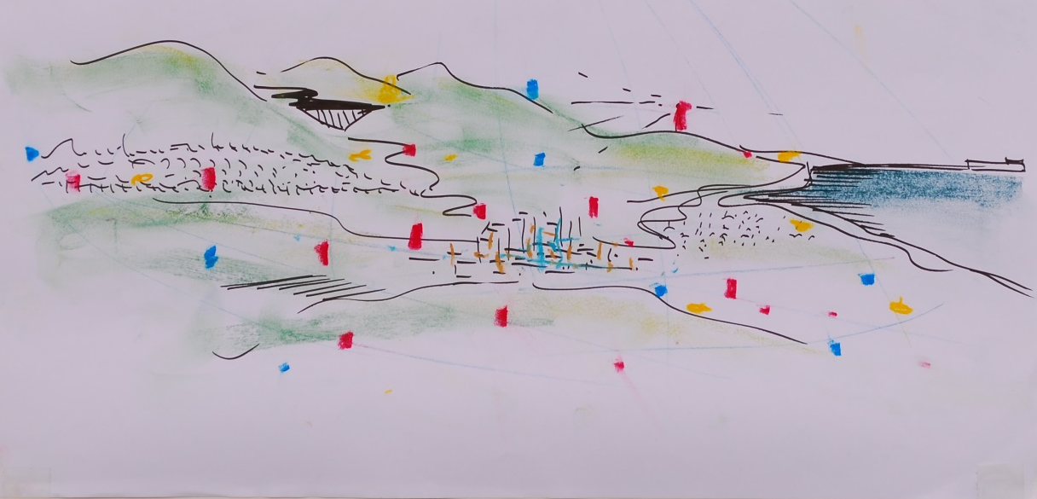
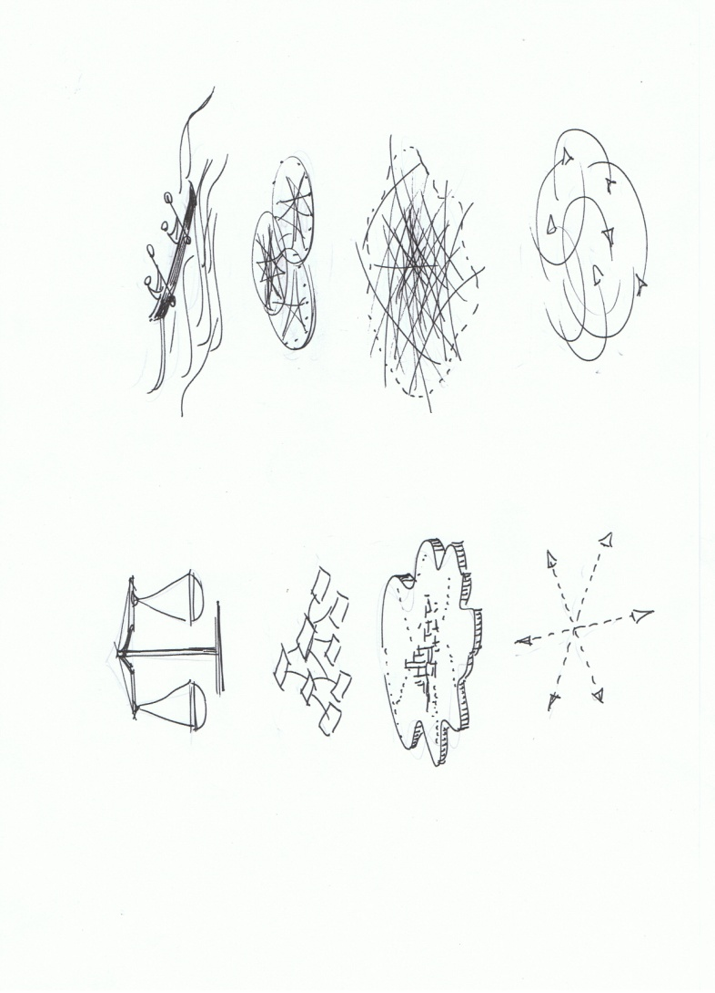
From sustainable to synergistic city-regions
Sustainable development model
Synergistic development model
Goals & directions: sustain / safeguard the city-region resources: (image - balancing present vs future needs)
Goals & directions: co-evolution of intelligent city-region (image – riding the waves of turbulence
Policy & action agendas: indicators , planning, regulation, market measures,
Policy & action agendas: social learning, creative collaboration, design for opportunity
Framing the city-region: an object with structured functions & boundaries
Framing the city-region: a dynamic hub, creative process, meeting point
Research agenda: vertical / horizontal / functional connections (supply chains, policy correlations etc)
Research agenda: social learning, synergistic intelligence, multi-value chains / cycles / constellations
Notes:
The key idea is about ‘transition’ from linear thinking to ‘synergistic’’. This picture shows the transition of ‘linear’ economic systems where the ‘winner takes all’, to ‘synergistic prosperity’

Slide 19
1st Mind-Game:

Slide 20
1st conversation:

Slide 21
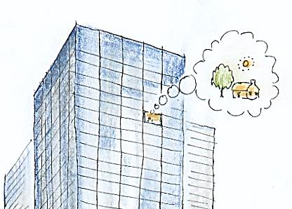

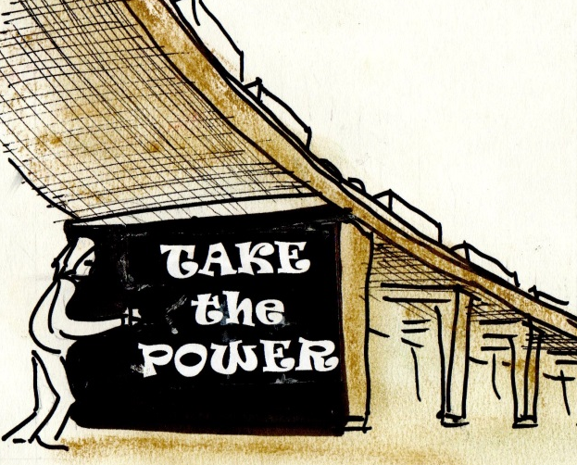
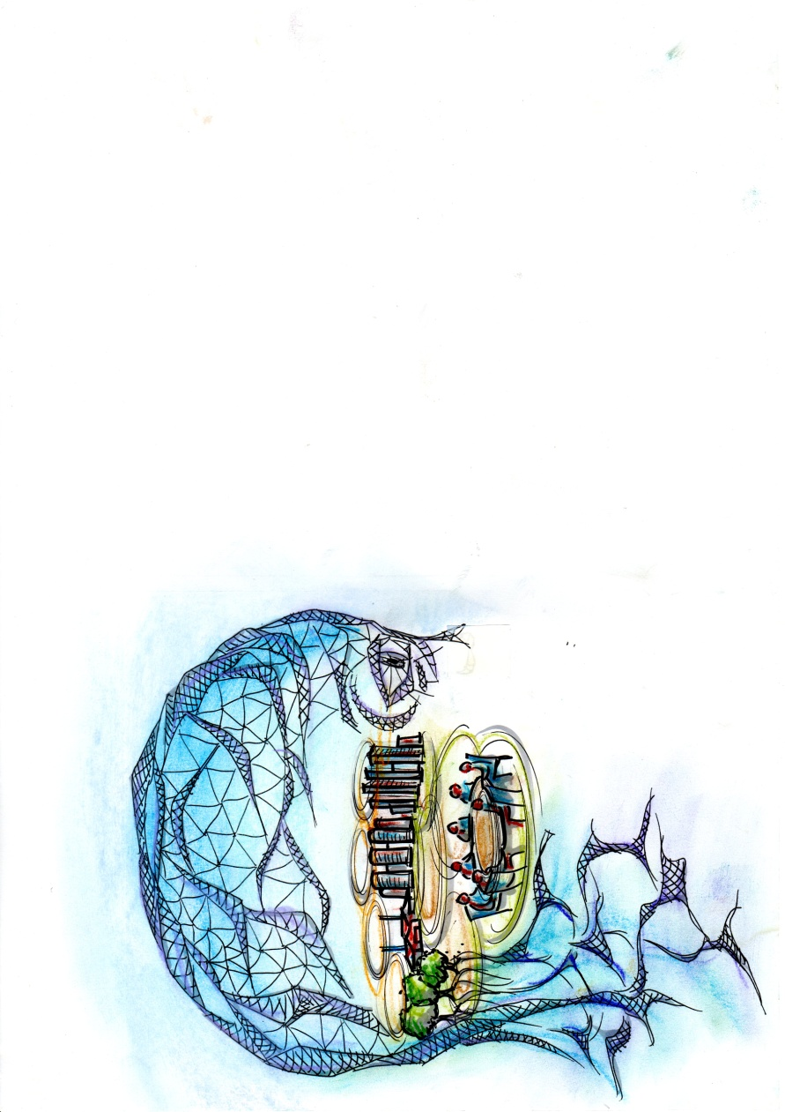
1st conversation
SAFE >>>> RISKY
How many research programs here are ‘NORMATIVE’’?? - aiming to make the world a better place.. (If not why not?)
How many are ‘CRITICAL’?? – questioning existing structures of power and hierarchy...
How many are CO-EVOLUTIONARY?? - looking for more advanced systems of learning and thinking???

Slide 22
2nd Case study: bio-regions

Slide 23
2nd science agenda: co-evolution

Slide 24
Sustainability science
Multi-scope, aiming at a whole systems perspective, in contrast to specific component or disciplinary knowledge.
Multi-valent, in combining different worldviews and systems of logic, e.g. social, technical, economic, ecological, political and cultural.
Multi-purpose, combining diagnostics / modelling / analysis, with prognostics / design / synthesis.
Multi-cognitive, with a reflexive process of deliberation, inter-subjective learning etc.

Slide 25
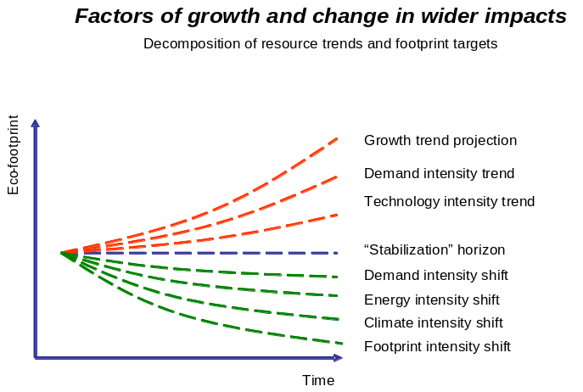
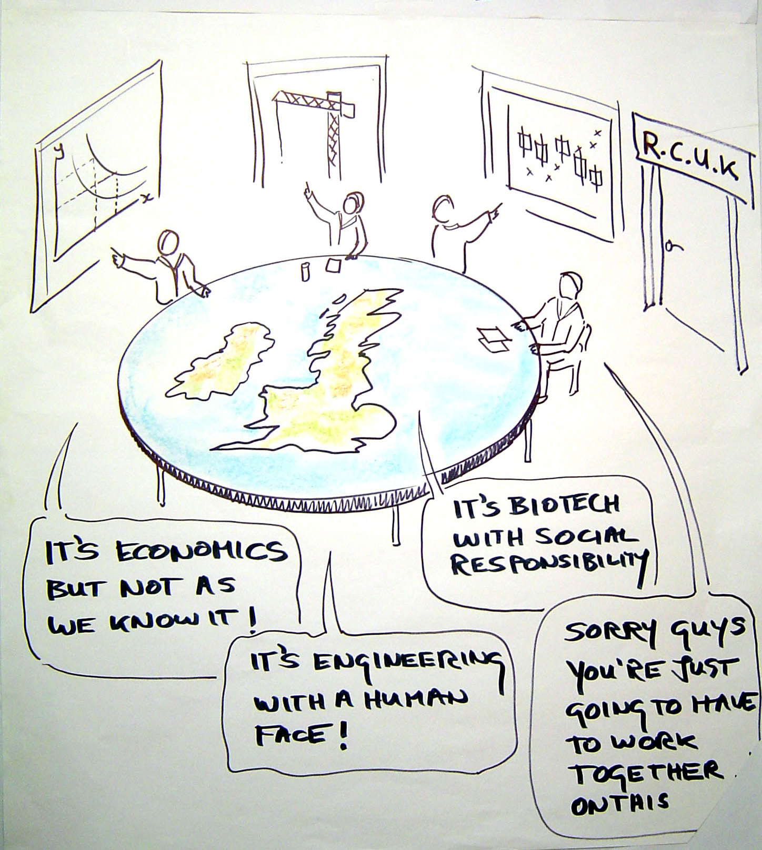
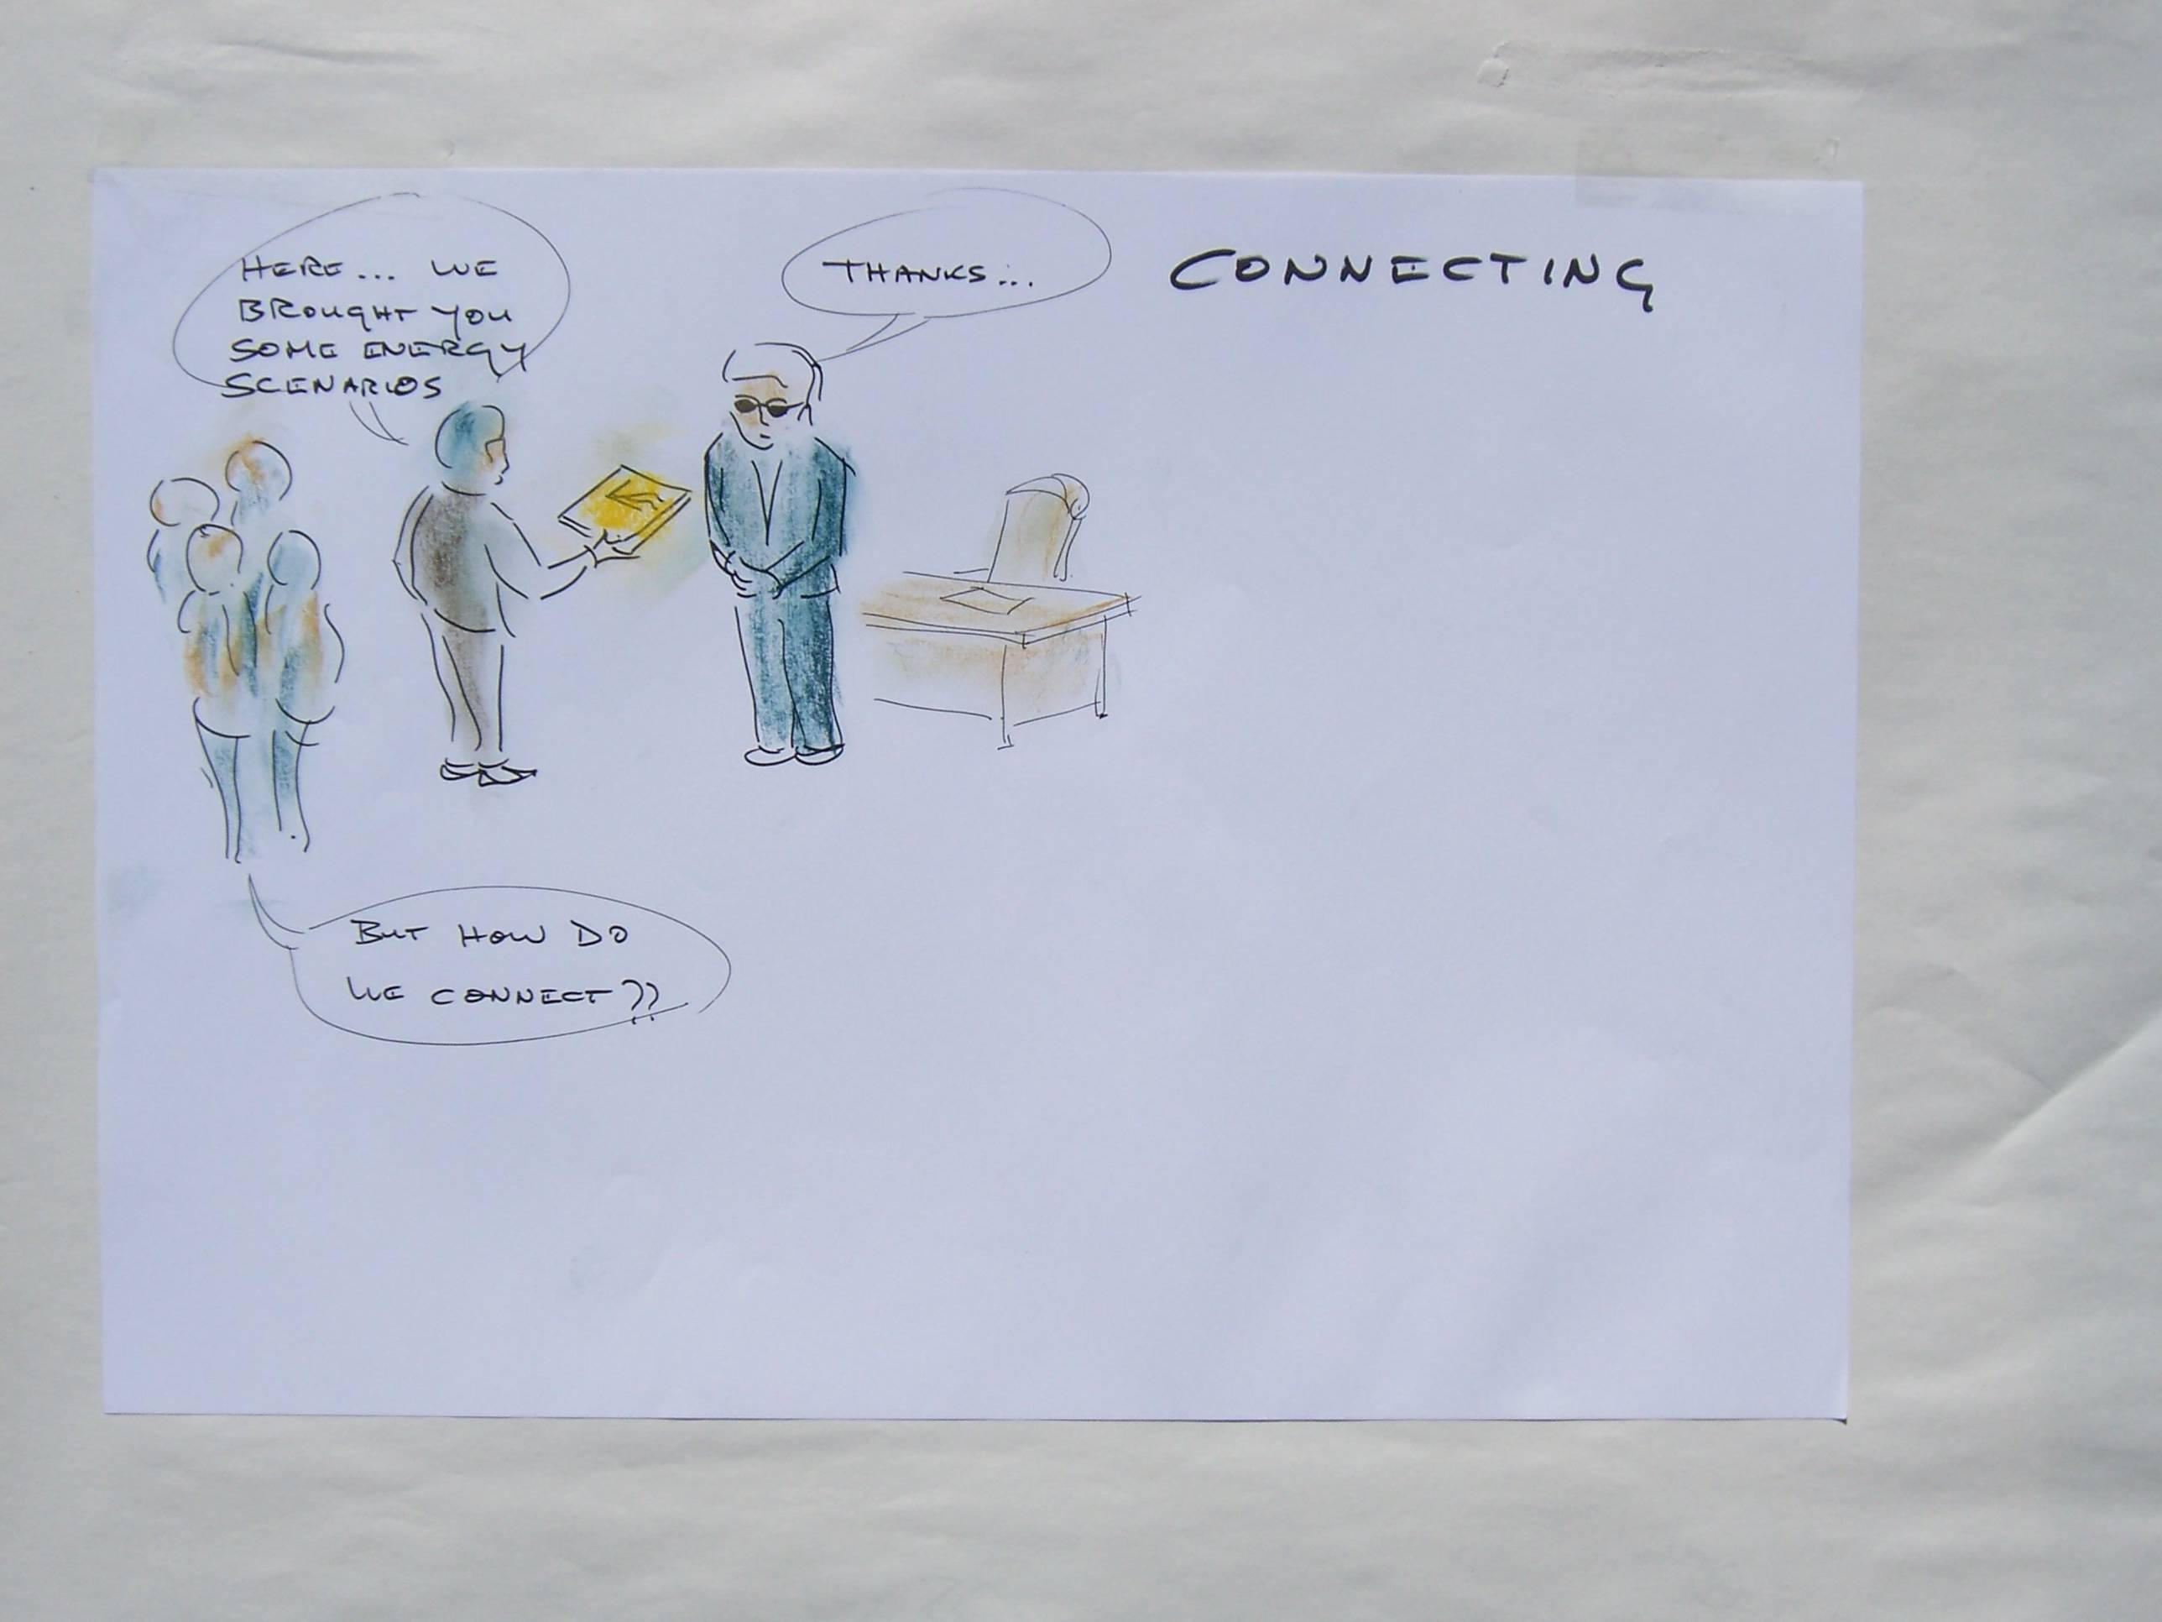
SCIENCE-3
Mr President, here are the scenario modelling results
Thanks...

Slide 26
Synergistic ‘reality’: works best with societal challenges: a multiplicity of mutual exchange & inter-subjective learning
Each domain has a distinct logic, worldview, learning & intelligence, cognitive process...
SYNDROMES: SCIENCE-1.0-2.0
SYNERGISTIC SCIENCE-3.0
Research results are presented to the ‘policy-makers’
Community & citizen science
Knowledge exchange, transfer, action learning
Social
Policy
Social
Policy
Ecology
Economics
Integrated systems science
Ecology
Economics
Knowledge exchange, transfer
Culture
Technology
Culture
Technology
Mono-valent ‘reality’: works best with technical problems, of low uncertainty & low controversy
Policy engages with business & technology
Inter-subjective & ‘Responsible R&I’
Big data, AI, social media
Synergistic knowledge: interface zones & inter-connectors
Synergistic learning: process of multi-cognitive discovery

Slide 27
SYNDROMES: SCIENCE-1.02.0
SYNERGISTICS: SCIENCE-3.0
SOCIETAL PROBLEMS...
SOCIETAL CHALLENGES...
SOCIETAL PROBLEMS...
SOCIETAL CHALLENGES...
Politics / journalism: ‘Unknown knowns’:
dilemmas, wicked problems, gaps, discontin-uities: ‘unknown unknowns’
‘Post-normal’ science: problematic knowledge: ‘we can deliberate but the solution is part of the problem’
Politics:
‘we can address societal problems’
?
???
OUTCOMES >>> CONTROVERSY`
OUTCOMES >>> CONTROVERSY`
Synergistic learning & knowledge cycles
‘we can navigate from one kind of reality to another’
?
Consultancy: ‘Known unknowns’:
Normal science:
‘we know what we are doing’
Consultancy:
‘we can solve technical challenges’
Normal science: ‘Known knowns’:
TECHNICAL PROBLEMS...
TECHNICAL CHALLENGES...
TECHNICAL PROBLEMS...
TECHNICAL CHALLENGES...
KNOWLEDGE >>> UNCERTAINTY
KNOWLEDGE >>> UNCERTAINTY
(Uncertainties in multiple domains)

Slide 28
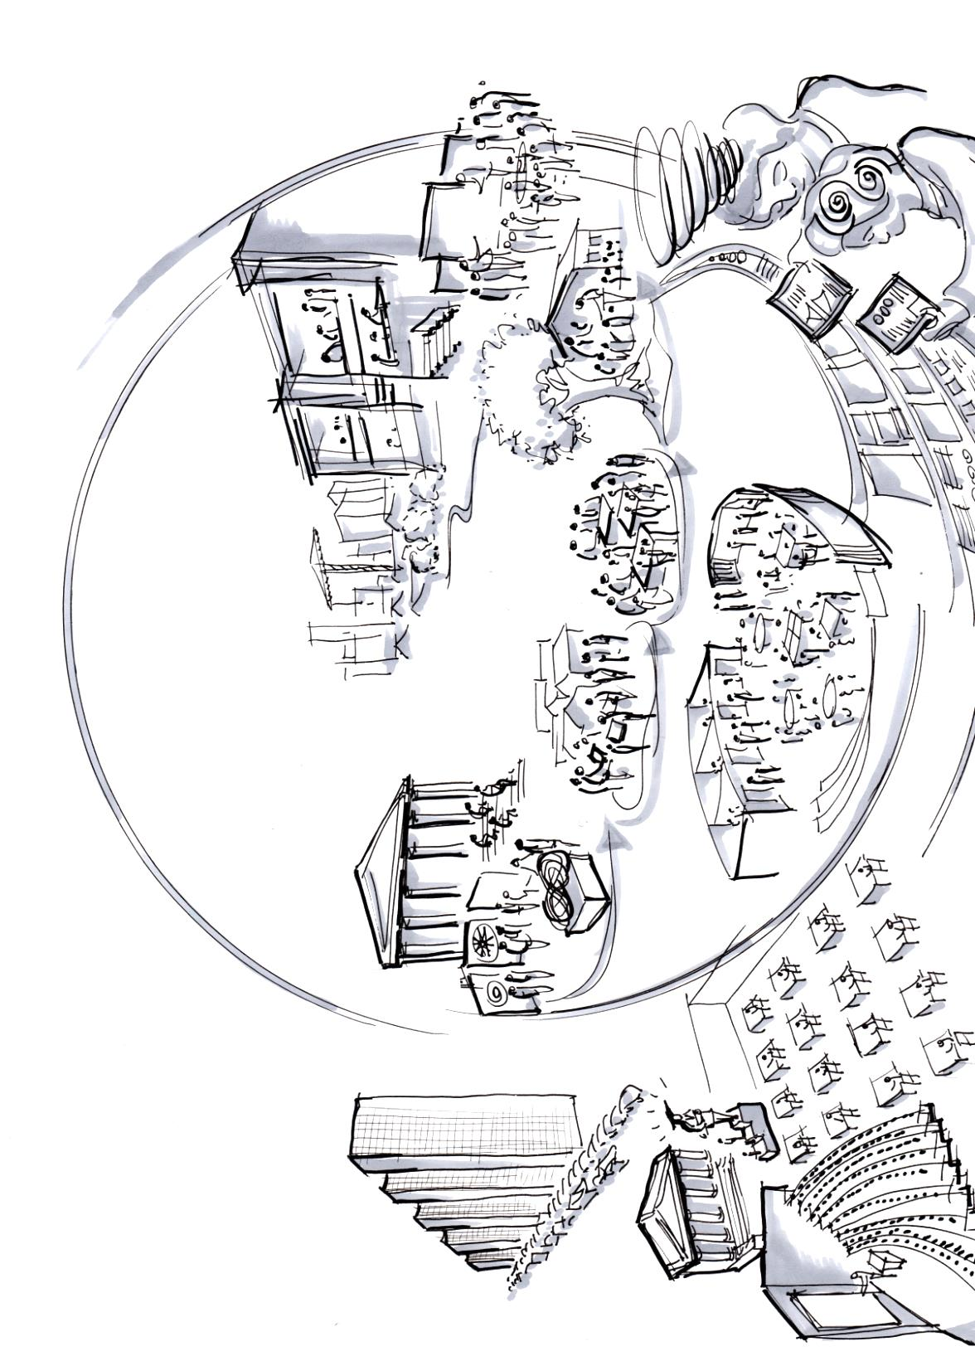
EDUCATION-3
Example: experiential education & institutional transformation at Arizona State University (Randles & Laasch, 2015)
LINEAR-EVOLUTIONARY
SYNERGISTIC – COEVOLUTIONARY MODEL
Live project work is the primary resource: students exchange teaching & learning together
Rounded graduates with life-long learning skills take active places in society
Content is orientated by systems & trans-disciplinary thinking
Raw graduates find niches in a dysfunctional & alienated economic system
Student evaluations by collaborative peer groups, panels & networks
Self-serving ‘academies’ maintain obsolete methods & ‘winner-takes-all’ competitions
Students apply skills in the community, & learn from users
Reflexive & deliberative learning comes via real world engagement
Students assimilate ‘facts’ via mass lectures / online courses
Mass lectures replaced by interactive / inclusive deliberation sessions, with space for all to speak
Students regurgitate ‘facts’ via competitive examination
Online systems mirror & support the real-time creative collaborations

Slide 29
LINEAR-EVOLUTIONARY EDUCATION 1.0-2.0
CO-EVOLUTIONARY EDUCATION 3.0
‘UPSTREAM’ institutions & frames
Inter-connected education ecosystem:
universities: government: civil society: finance: professions: R&I : teachers: employers: community: students etc
Linear type institutions, fixed responses to known problems
Hierarchical structure & materialist value & exchange system
Multiple inter-connected value systems, actor relations, organization structures
‘PROCESS’: learning programmes
Pro-active evaluation & feedback
Outcomes: rounded students active in society
Outputs: exam passes
Objective & frame: curiosity driven, creative ‘Mode 2&3’ learning
Student output: projects, initiatives, collaborations
Objective: passive information gathering & ‘Mode 1’ learning
Objectives
Evaluation
Outcomes
Inputs
Outputs
Objectives
Outputs
Process
Inputs
Process
Student inputs: textbooks, lectures
Process: information competitions
Student inputs: inspiration, curiosity, human resources
Process: collaborative learning by doing
‘DOWN-STREAM’
Skills, knowledge, intelligence
ECON
TECH
Creative, collaborative, entrepreneurial types of skills & knowledge
ECON
TECH
CUL
SOC
CUL
SOC
ENV
POL
ENV
POL
Generally a mono-functional ‘techno-economic’ intelligence, knowledge & skills
Generally an inter-connected multi-value skills / knowledge system

Slide 30
2nd conversation

Slide 31
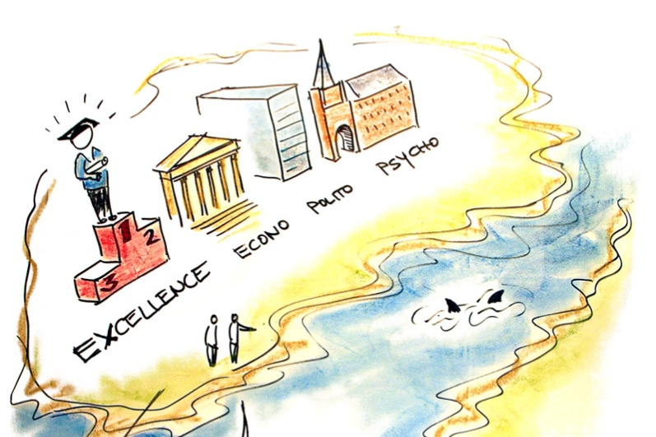
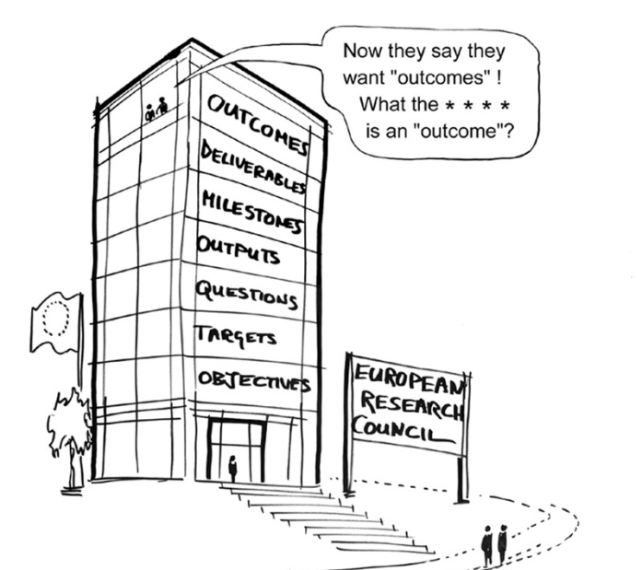
2nd conversation
How many research programs here are ‘MULTI-SCOPE’?? aiming at a whole systems perspective (trans-disciplinary)..
How many are ‘MULTI-VALENT’?? combining different worldviews, e.g. social, technical, economic, ecological, political, cultural.
How many are MULTI-PURPOSE?? combining diagnostics / modelling / analysis, with prognostics / design / synthesis.

Slide 32
2nd Mind-Game:

Slide 36
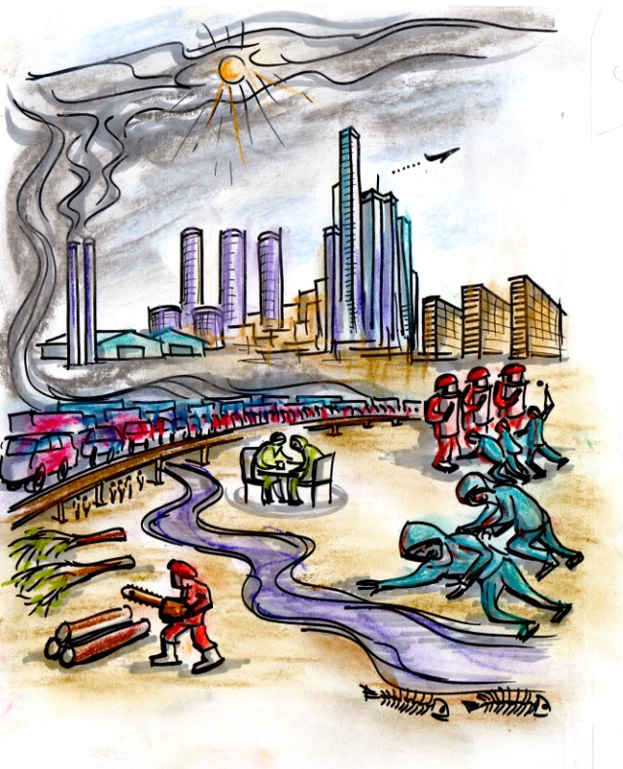
INTRODUCTION TO THE ‘URBAN SHARED MIND’
DON’T THINK ABOUT IT
THINK ABOUT IT
The global bio-spheric balance is ****ed
Finance rules the world to enrich itself
The global bio-spheric balance is based on the shared mind
Finance now serves the world for real wealth & prosperity
Government departments all in silos
maximum security projects for the under-classes
Government is now responsive & connected
Industry pollutes air & water, for useless products
Industry now recirculates resources
Urban infra-structures are out of control
Infrastructure self-organizes with tendrils
Deliberation is at the heart of the collective mind
Natural resources are turned to dust for profit
Weaving the synapses of society for the next stage of co-evolution
Natural resources are stewarded for all
Destruction of humans & flora & fauna is the order of the day
Deliberation will be risky for those involved
The point is, the previous world is quite stupid... Government, industry, finance… not much thinking capacity
Ok hands up who wants to live in this world??
Ok i get it... .you want intelligent cities? Economic wisdom?? Let me think about it...
I can see some advantages... iPhones.. SUVs.. Big Macs...

Slide 37
INTRODUCTION TO SYNERGISTIC THINKING & ‘URBAN SHARED MIND’
UNTHINKING – SYNDROMES
THINKING – SYNERGIES
System is geared to extraction of profit
Profit & value are re-circulated
Hierarchical governance for the elite
Collaborative governance for all communities
Economies are alienating, extractive, wasteful of resources
Economies are collaborative, responsive, economical with resources
Cities are mono-use, machine scale, disconnected
Cities are multi-use, human scale, inter-connected
‘Citizens’ are passive, disempowered, fragmented
‘Communities’ are active, self-organized, networked
You seem to be against capitalism... But everyone knows the alternatives are much worse
Actually, it’s about ‘real’ social & ecological capitalism – not just ‘winner takes all’ profiteering – but ‘winners are all’ prosperity.

Slide 38
WHERE TO START: LOW CARB CITY EXAMPLE
1) FROM SYNDROMES TO SYNERGIES
Welcome to the “Synergistic Mapping” Quick Tour (with Low-Carb demo)”…
Housing is a Ponzi scheme… energy & water are casino chips
Government can’t keep up with the forces which really run the city
This Low-Carb City looks like a mess… nothing fits…
So this Low-Carb thing - is it an economic cost, technical challenge or social dilemma???
The elite pull all the strings… society is fractured
Our building stock basically warms the sky
Yeah – if we can’t agree on the problem how are we going to find a solution?

Slide 39
WHERE TO START: LOW CARB CITY EXAMPLE
SYNERGISTIC METHODS
CO-EVOLUTIONARY ‘1-2-3.0’ MODELS
So how d’you do this ‘synergistic’ thing??
Easy – first you get people round a table. Then you ask how they get along, & what they do, & how they create “value”...
Some synergies are like parts of a machine… others more biological & others human - it’s like “1-2-3”.
‘1.0’ - a mechanical kind of synergy: this city could be ‘CLEVER’
(& get an artist to draw if possible)
social, economic, ecological or political values?
‘2.0’ - more of a biological synergy, where winners take all: a city which is ‘SMART’
‘3.0’ is really a human kind of synergy, with learning & thinking, where ‘winners are all’: this city is more like ‘WISE’
All of them… you might need a different table for each
And then you look for increased value & reduced conflict, with new inter-connections & synergies

Slide 40
I
CO-EVOLUTIONARY / SYNERGISTIC ‘WISE’ SYSTEMS : (“3.0”)
Positive value (financial, political, ideological etc), is recirculated
this WISE city isn’t just about money or CO2, but art, ecology, community..
An ‘intelligent’ system - more like a human brain. Each component is part of a whole which learns, thinks, creates, designs.
The ‘intention’ or ‘design’ or cognitive ‘intelligence’ is now in all domains of the system
Complex decisions need round tables
Production is self-organized & networked
Negative impacts are internalized, low-zero waste etc
Nice … but how to stop the bad guys taking over again??
3.0: ‘cognitive adaptive systems’ are shaped by human qualities of thinking, learning, questioning – a ‘co-evolutionary’ model of ‘winners-are-all’:
A successful 3.0 city would be ‘wise’.
We are not only material consumers but humans who share, learn, create & think

Slide 41
2) Clever / smart / wise cities

Slide 42
CLIMATE-PROOF CITY: CARBON CYCLE
Agriculture CO2 & other GHG
Aviation CO2 & other radiative forcing
CO2 sequestered in forestry, soil & land
Energy conversion & distribution system
Commercial in/direct CO2 & downstream climate responsibility
Fossil fuel extraction & fugitive emissions
Inbound marine shipping: direct & embodied CO2
Domestic building in/direct CO2 & supply chain
Outbound marine shipping: direct & embodied CO2
Urban transport / infrastructure in/direct CO2
Industrial production & distribution in/direct CO2
Waste stream GHG & embodied CO2 emissions
Fossil fuel reserves extracted
Carbon long term storage in buildings, urban infrastructure, durable products.
Carbon capture & storage in fossil fuel formations

Slide 43
EXAMPLE: “RETROFIT-3”: OVERVIEW
LINEAR MODEL: “UK GREEN DEAL 2013”
SYNERGISTIC MODEL: “GREEN DEAL 3.0”
Housing & other buildings are financial objects without connections.
Apartments have split incentive barriers to efficiency
Physical building is inter-connected with ecology, finance, social, policy, technology value systems
A digital ‘platform’ (eBay / wiki / Amazon / FB etc, is the information connection
Houses are dis-connected from neighbours.
Unplanned ventilation loses heat
A human ‘market-place’ is where people play the role of agents /entrepreneurs /intermediaries / creatives
Waste is sent to landfill
Glasshouse conservatory is heated
Lifestyle includes high power cars & long haul flights
The household is fully integrated: waste, energy supply, ventilation, heat storage, waste recycling, personal transport

Slide 44
EXAMPLE:‘RETROFIT-3’: ACTOR PATHWAYS
ACTORS & SYNDROMES: “GREEN DEAL 2013”
ACTORS & SYNERGIES: “GREEN DEAL 3.0”
media & public sceptics
Disconnec-ted ‘year zero’ policy
Unstable & under-funded
Positive media stories
Social collateral & policy intel
Procurement for eco-inno-vation
Piecemeal design approach
Public housing in a mess
building health mentor role
trusted inter-mediary role
Civic & society
Govern-ment
Public service
Civic & society
Govern-ment
Public services
Science / tech
Social / commun
Science / tech
Social / commun
Profes-sions
Public housing
Profes-sions
Public housing
Finance & devt
Private housing
Finance & devt
Private housing
High finance charges & costs
Construction
Infra-structure
Labour & skills
Private HH inform-ation gaps & inertia
Mutual finance investment & return
Proxy markets / incentives for savings
Construct ion
Infra-structure
Labour & skills
low take-up, frag-mentation
Skills gap, job insecurity
Top-down, distrust, uncertain
Re-socialize utility firms as mutuals
community builder
role
Performance / skills incentive SMEs & workers

Slide 45
EXAMPLE:‘RETROFIT-3’: FACTOR PATHWAYS
PATHWAYS FROM: “GREEN DEAL 2013”
PATHWAYS TO : “GREEN DEAL 3.0”
Finance gap: asymmetric info & distrust: high profit margins: high viability hurdles & short horizons
CIV
GOV
PUB
CIV
GOV
PUB
‘Finance pathway’: links owners, agents, utilities, builders, via integrated mutual-type ‘finance hub’
STI
COM
STI
COM
Finance for innovation
PRO
PH
PRO
PH
FIN
OH
FIN
OH
CON
INF
LAB
CON
INF
LAB
Innovation gaps: Inertia & uncertainty: low invest in technology, plant, skills:
Innovation for finance
‘Innovation pathway’: Technical-professional skills, regulation, standards, led by ‘procurement hubs’
Institutions for innovation
Institutional gaps: Split incentives: owners / landlords won’t invest for benefit of future owners / tenants
‘Institutional pathway’: new tenure & stewardship models via agency for combined value chain incentives
Finance for institutions, etc..

Slide 46
SUPPLY-DEMAND-VALUE CHAINS & TRANSITIONS
LINEAR / EVOLUTIONARY VALUE CHAIN
SYNERGISTIC / COEVOLUTIONARY CHAIN
Affluent societies growing piles of stuff
Possible high energy & service costs
Limits on consumption in affluent society
Free goods & externalities
Price dependency on market psychology, fashion etc
Possible unique resources
Affluent societies move to sharing models
energy & service costs reduced to zero
Consump quality based on social, ecological values
Price linked to wider services / use values
Owner value
Extended functions
Direct consump
Owner value
Extended functions
Direct consump
Social, cultural, ecological
Purchase price
Social, cultural, ecological
Purchase price
Factors of produc-tion
Sale price
Factors of produc-tion
Sale price
Capital value
Entrepre value
Labour value
Capital value
Entrepre value
Labour value
Factor values built into sale price
market is manipulated by advertising
Products designed for profit of investors
Entrepren incentives for short term gain
Workers on insecure low wage contracts
Factors linked to socio-ecological value
market is based on shared intelligence
Finance diversified finance for wider value
Entrepren rewarded for social value
Workers are stakeholders & owners

Slide 47
CLEVER – SMART - WISE
‘CLEVER’ CITY 1.0:
‘SMART’ CITY 2.0
‘WISE’ CITY 3.0
‘free market’ with low mutual information
New platform & market operators: info & values extracted
Providers
Purchasers
Marketplace of rich information & extended value chains
Individual trades
Providers have info on demands
Purchasers have info on opportunities
New business models for interme-diaries
Social costs are dumped

Slide 48
INFORMATION – KNOWLEDGE – INTELLIGENCE – WISDOM
Argyris & Schon 1993: Shroff 2013, ‘Intelligent Web’
Typical ‘item’ / ‘issue’: upstream / downstream format
LEARNING MODELS
ITEMS / ISSUES
(neurons)
SINGLE-LOOP:
information
Implemen-tation
LINKS
(synapses)
Links can be of 4 types
Policy & programs
Monitor & observation
Local hashing clusters
STORIES
(neural networks)
Assess & adjust
Collaborative filtering
FORUMS (learning)
DOUBLE-LOOP:
knowledge
Evaluate & review
Associative sense-making
DATA (memory)
Deliberate & rethink
Semantic cognition
ANALYSIS (processing)
MULTI-LOOP:
intelligence
Creativity: combinat-orial: exploratory
INNOVATION / DESIGN (imagination)

Slide 49
EDUCATION 3.0
Example: experiential education & institutional transformation at Arizona State University (Randles & Laasch, 2015)
LINEAR-ADAPTIVE MODEL
SYNERGISTIC MODEL
Live project work is the primary resource: students exchange teaching & learning together
Rounded graduates with life-long learning skills take active places in society
Content is orientated by systems & trans-disciplinary thinking
Raw graduates find places in a dysfunctional & alienate economic system
Student evaluations by collaborative peer groups, panels & networks
Self-serving ‘academies’ maintain obsolete methods & ‘winner-takes-all’ rankings
Students apply skills in the community, & learn from users
Reflexive & deliberative learning comes via real world engagement
Students assimilate ‘facts’ via mass lectures / online courses
Mass lectures replaced by interactive / inclusive deliberation sessions, with space for all to speak
Students regurgitate ‘facts’ via competitive examination
Online systems mirror & support the real-time creative collaborations

Slide 50
3) Next steps

Slide 51
Next steps
General aim … to enhance the native intelligence & shared mind of the urban system & all its stakeholders.
Shift from ‘evolutionary’ to ‘co-evolutionary’ ways of managing complex problems.
look at the ‘smart cities ‘ agenda …. what are we trying to achieve??… .what could go wrong??…. What are the hidden resources??
E.g. City Foresight Platform - first phase: a 2-year pilot programme - two main aims:
to collect and inter-connect existing schemes and projects on a futures / foresight axis,
to learn from them, through a structured programme of research-policy exchanges.
second & third phases: more advanced social learning processes, A.I. (artificial intelligence) technologies, and creative prototyping, action learning, design thinking, living labs etc.

Slide 52
THANKS .... Work in progress www.urban3.net
Urban 3.0
Creative synergy & shared intelligence for the one planet city
“Environment and the City” - critical perspectives on the human urban environment around the world
“World’s largest feasibility study” – linking spatial, economy, environment, society, governance.
“Local / global transition strategy” – mapping & design of post- complex challenges & opportunities

Slide 53
SYNERGY MAPPING
Synergy mapping explores the more ‘emergent’ kinds of thinking: changes to the whole are greater than the parts.
G
LINEAR / ‘CLEVER’ SYSTEMS : (“1.0”)
The ‘intention’ or ‘intelligence’ is external to the system.
the director / boss / general is in charge
Firstly, this linear “1.0” type system is basically hierarchical, mechanical & predictable
the filing systems look well organized
Each domain layer is organized, according to a more or less fixed design.
The workers seem to be productive… what could possibly go wrong?
The crystal ball shows a functional system, with image of a large & complex machine. A successful ‘1.0’ type city might be stupid or ‘CLEVER’…. but can’t adapt or evolve for new challenges.
This city might look CLEVER… but it’s about as stupid as a machine with just one function

Slide 54
H
EVOLUTIONARY / ‘SMART’ SYSTEMS : (“2.0”)
Now for some real incentives… we could make a billion or 2 here
Positive value - financial, political etc – is expropriated by the elite & the super-systems.
Then we see an emergent system, as in evolutionary biology. Each component adapts, finds / creates niches & evolves over time
we need SMART managers who can think on their feet
The evolutionary ‘intention’ or ‘design’, or ‘intelligence’ (for human systems) is in a few layers
higher productivity = lower wages!!
Negative impacts are dumped (‘externalized’) on the vulnerable & the sub-systems.
It’s nature’s way – big fish eat the little fish & so on
‘2.0’ evolutionary change works in ‘complex adaptive systems’: a wild west model of ‘winner-takes-all’ – an image of a biological jungle. A successful ‘2.0’ city would be ‘SMART’.
we also have ways of making them consume... (there’s money in low-carb diet plans)

Slide 55
SYNERGY FORESIGHT PROCESS
Here’s a typical ‘Synergy Foresight’ programme. This does synergistic mapping & design in 4 main stages & 12 steps
I’s a flexible menu - can take 4 hours, 4 days, 4 weeks or 4 months
The picture shows all 4 stages in 1 room (in reality would be at different times)
At the start, the more things are set up the better – agenda, people, resources etc
First stage is the ‘landscape mapping’ … we explore & draw maps of ‘what is our problem’ & ‘how does this system work’?
Second, the ‘change mapping’ – looks at trends, dynamics, alternative scenarios
(mappings & visuals)
Put visual materials etc on the wall for cross-fertilization
(Tables for specialist discussions)
Finally - either go around the cycle again – or take it out to the world
Fourth stage – ‘pathway / road-mapping’ – here we converge back to practical strategy & action.
Third stage, ‘synergy mapping & design’… the creative side… we look for new collaborations, alignments, learning exchange etc

